Slide 1
Blog Coursework

Slide 2
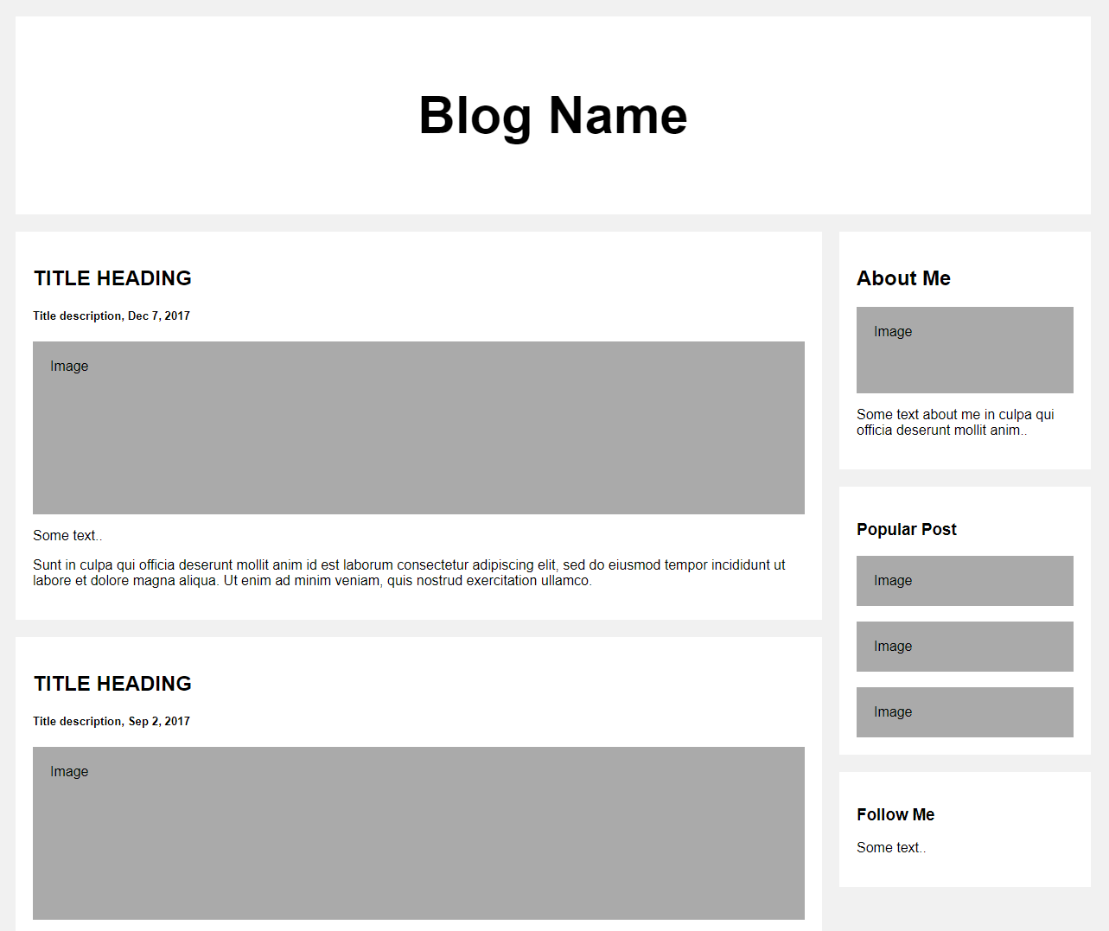
Template from w3 schools

